Slide 1
Logistic Regression and Decision Tree Regressor for Diagnosing Cancer
Padraig Buckley

Slide 2
Data
Features
UCI Breast Cancer Wisconsin dataset
Internal Breast Cancer dataset
Internal Ovarian Cancer dataset
UCI:
Cellular features (clump thickness, uniformity of cell size, uniformity of cell shape, etc.)
Internal
Glycopeptide signals

Slide 3
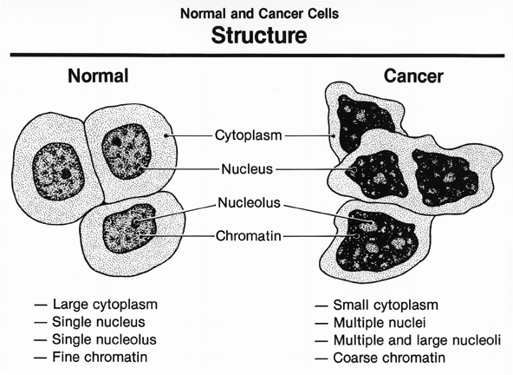
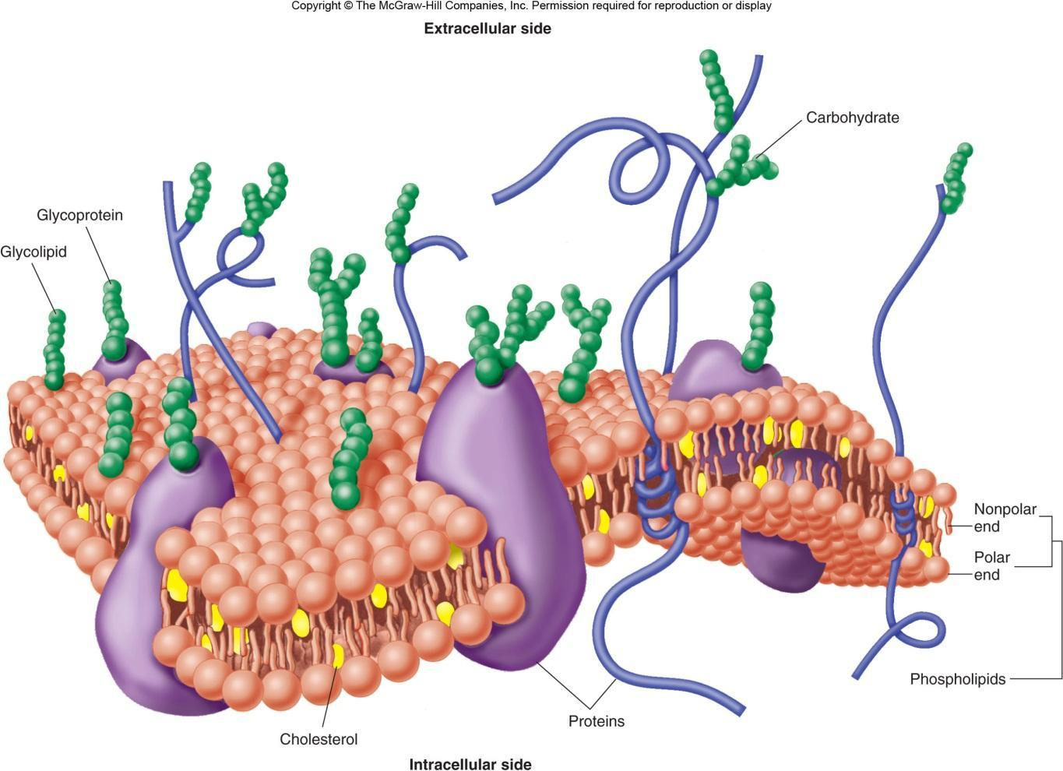
Glycoprotein

Slide 4
Training and Testing Set Results – Logistic Regression
 | UCI Breast Cancer | Internal Breast Cancer | Internal Ovarian Cancer
Training accuracy | 97% | 99% | 100%
Testing accuracy | 96% | 82% | 88%
Training Sensitivity | 97% | 94% | 100%
Testing Sensitivity | 96% | 46% | 85%
Decision Tree Regression Accuracy for UCI Breast Cancer = 96%

Slide 5

Thanks and good luck everyone!

